Slide 1
Railway E-Ticketing System
Course Name: Object-Oriented Analysis and Design(OOAD)
Course Faculty: Mahfujur Rahman
Section: F
Group: 02

Slide 2
Presented by
1.Name: Nafinur Leo
ID: 20-42195-1
2.Name: Ratul Hasan Rahat
ID:19-40647-1
3.Name: Tasnuba Kader Raisha
ID:19-39616-1
4.Name:Monowara Parvin
ID:19-39578-1
5.Name: Maisha Tahiat
ID: 19-39581-1

Slide 3
Outline:-
Introduction
Motivation And Background
Purpose And Goal
Use Case Diagram
Class Diagram
Sequence Diagram
State Chart Diagram
Activity Diagram
Conclusion

Slide 4
Introduction
This system is basically concerned with the reservation of railway tickets to the travelers.
In this, we are going to discuss an Object-Oriented model for Railway E-ticketing System.

Slide 5
Motivation And Background
A central portal to enjoy the advantage of booing tickets of any train anywhere in Bangladesh.
Model of existing Railway E-Ticketing System
Provide different scenarios to specify the system
Diagram is provided to justify the scenarios
Reduce booking expenses by eliminating printing and mailing paper document cost

Slide 6
Purpose And Goals
Purpose: The purpose of this project is to develop an Object-Oriented model for Railway E-Ticketing System.
Goals: Railway E-ticketing System is an interface between the travelers, clerks and railway system. It aims at improving the efficiency in the issue of tickets and reduces the complexities.

Slide 7
Case Study Use Case Diagram
Railway e-ticketing system is software developed to computerize the process of possessing a travel ticket. In railway e-ticketing system, the primary actors are travelers and clerk and the secondary actor is railway system. Travelers, clerk and railway system login to their accounts. Travelers can select destination, search availability of tickets, view ticket details, book ticket, fill form, pay amount, confirm reservation and request for tickets from their account. Clerks can also view ticket details, confirm reservation, cancel reservation and return money. Railway system can make ticket available for both travelers and clerks. Here, it is mandatory to set ticket details before ticket available. Railway system can create form, modify form, return money, assign clerks etc. Moreover, railway system can confirm reservation by response to request.

Slide 8
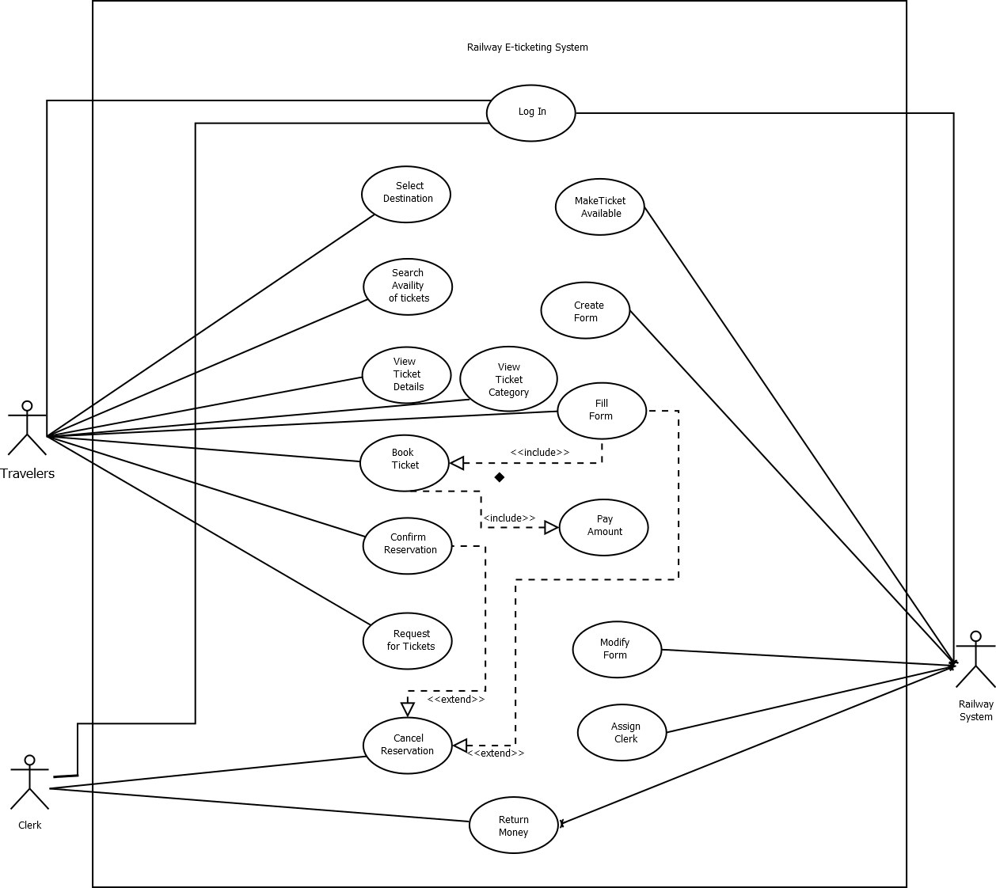
Use Case Diagram

Slide 9
Case Study Class Diagram
Travelers can buy any number of tickets. Travelers can login, select destination, search availability of tickets, view ticket details, book ticket, fill form, pay amount, confirm reservation and request for tickets from their account. Every ticket has no, status, person number etc. Clerk can confirm reservation, cancel reservation, and return money. Train has name and no. Railway system can make tickets available and assign clerks.

Slide 10
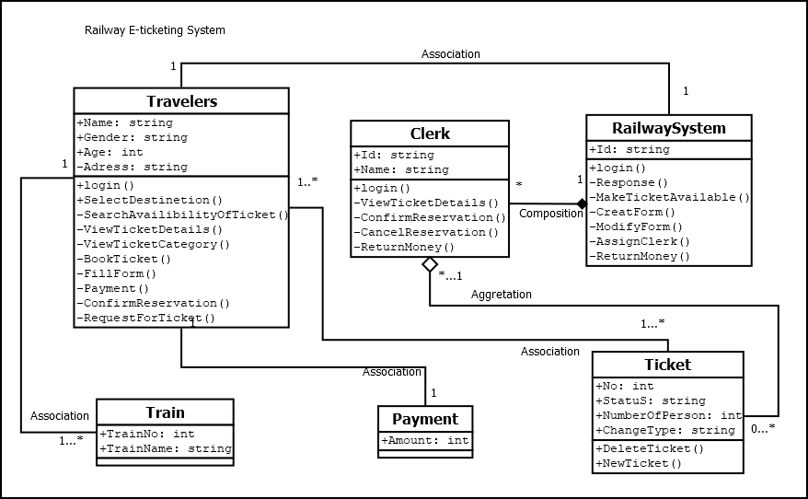
Class Diagram

Slide 11
Case Study Sequence Diagram
A traveler requires booking a ticket through internet. Travelers will login and request to reserve a ticket to the railway system. Railway system receives the request and then the request passed it to clerk. Clerk checks the current booking database to find out the availability of seat, seat number and facilities. Facilities are sending to the system through clerk. Travelers can show available seats and then confirm their desires seat. Then railway system passed the requested seat to the clerk .Clerk confirmed the seat through database. Eventually a copy of the ticket is sent to the system and a copy is given the travelers.

Slide 12
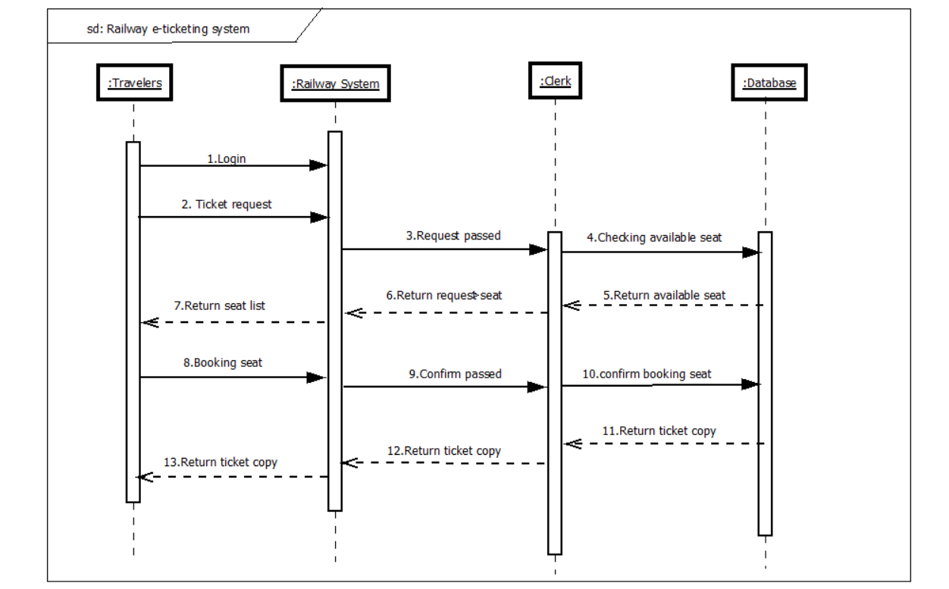
Sequence Diagram

Slide 13
Case Study State Chart Diagram
The travelers will login to the railway system. If the login fails, the travelers will go back to the homepage. If the login succeeds, the travelers will enter the page containing ticket details. Then the travelers will fill up a form and then will choose the seat and get the specification of the ticket. The traveler will confirm the reservation. If the payment method is invalid, the travelers will go back to the homepage. If the payment method succeeds then the travelers will get the ticket and end up process.

Slide 14
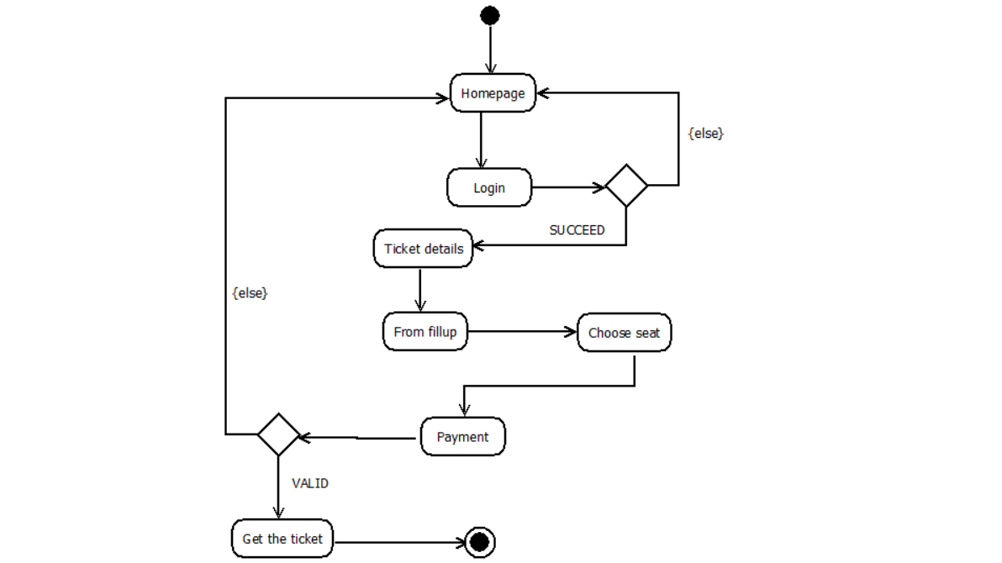
State Chart Diagram

Slide 15
Case Study Activity Diagram
First system creates available seats for both clerk and travelers. The system shows the ticket details to the clerk and travelers. After viewing the ticket details, travelers choose the seats and fill up the forms. System assigns the clerk to accept the reservation request. If the seats are available, clerk confirm the reservation request. If the seats are not available, clerk request to the system to assign another available seat. Then system views the request and assigns available seats to travelers. After that travelers can confirm their reservation.

Slide 16
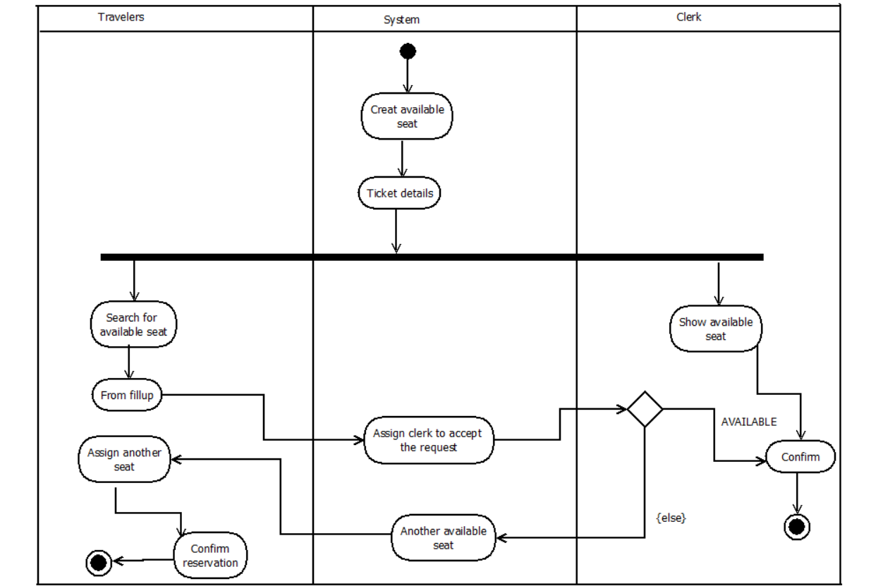
Activity Diagram

Slide 17
Conclusion
The main aim of developing reservation system is to provide all information that is required by the users. The system will offer a complete management system that integrated with ticket reservation to help the travelers for getting their tickets in short time. The program is just an example of the original online railway reservation system. We tried to cover all the concept related to the topic.

Slide 18
Thank You

